Slide 1
Capstone Project
Alejandro Yanez

Slide 2
Objetive
Build a CI/CD pipeline with the concepts, tools and technologies learned during the training

Slide 3
Build a continuous delivery pipeline to deploy a Flask Python application.
Pull code from the repository, build and test the resulting Docker image.
Push the containerized application to Docker Hub.
Configure and set up a linux based Kubernetes cluster. Deploy 3 replicas of the application(from DockerHub) using Ansible to your kubernetes cluster

Slide 4
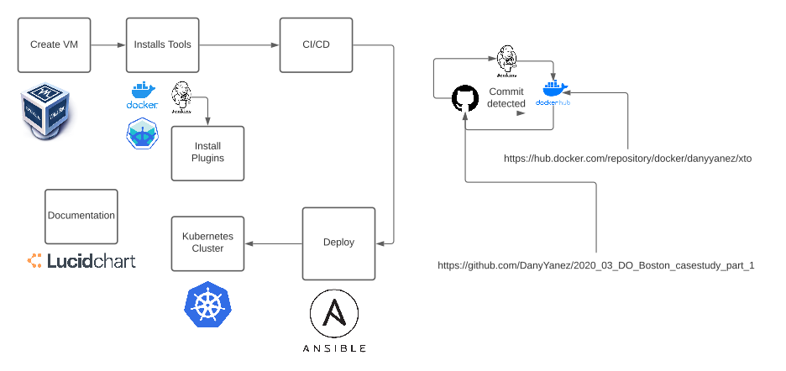
Design Phase

Slide 5
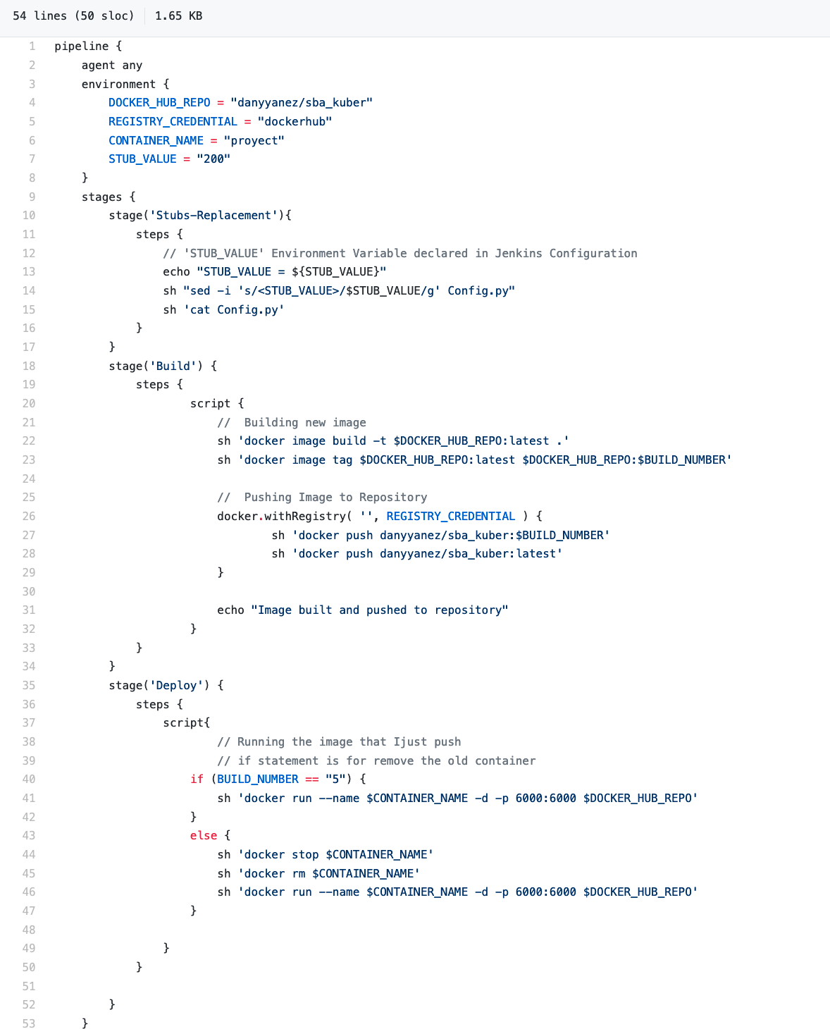
Setup Phase

Slide 6
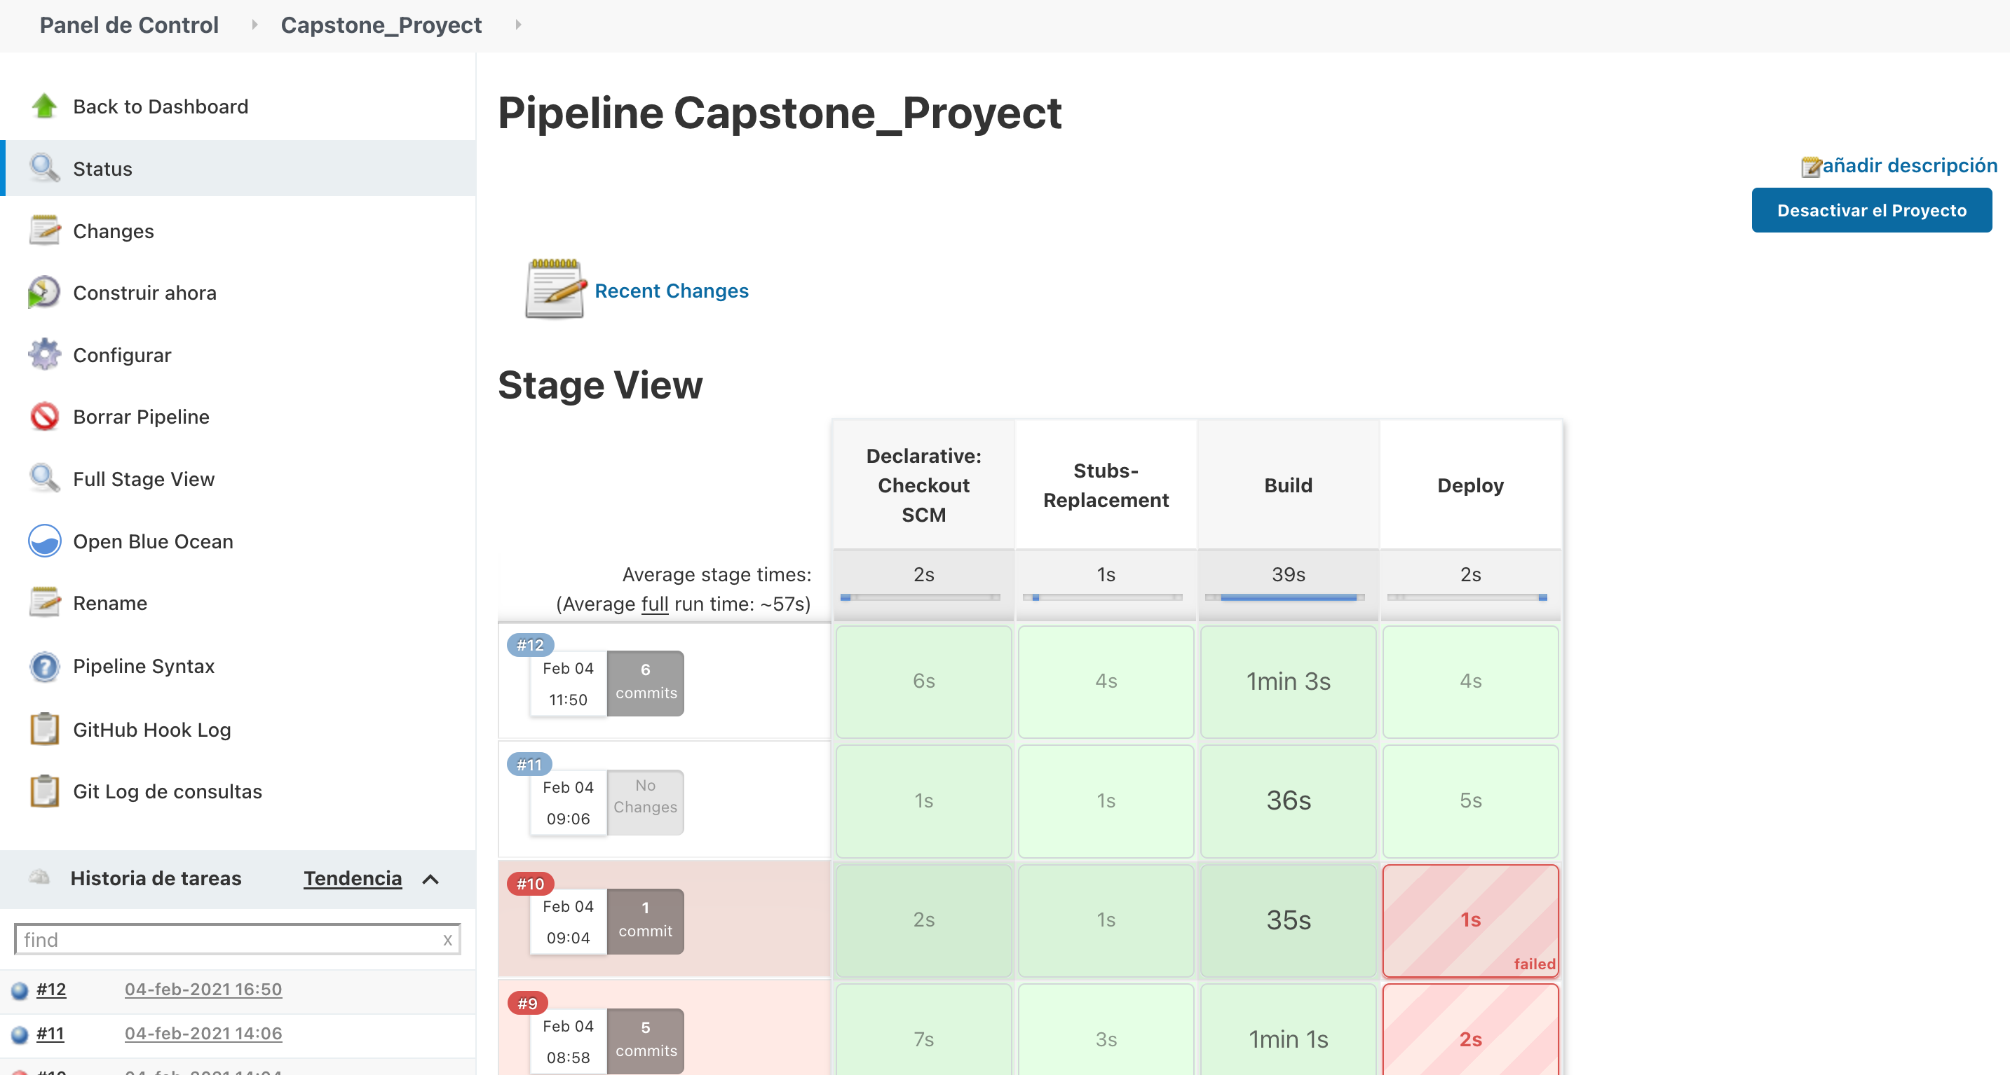

Slide 7
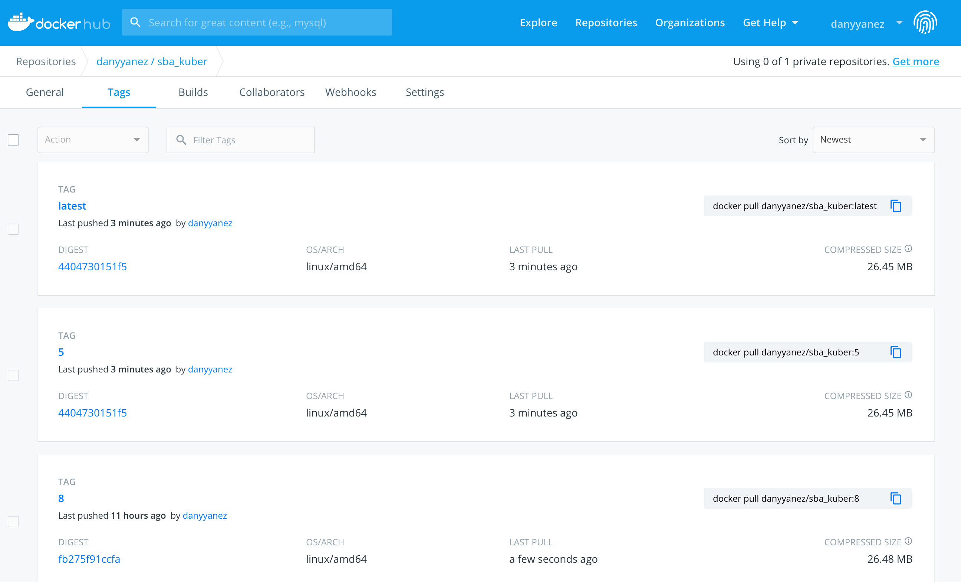

Slide 8
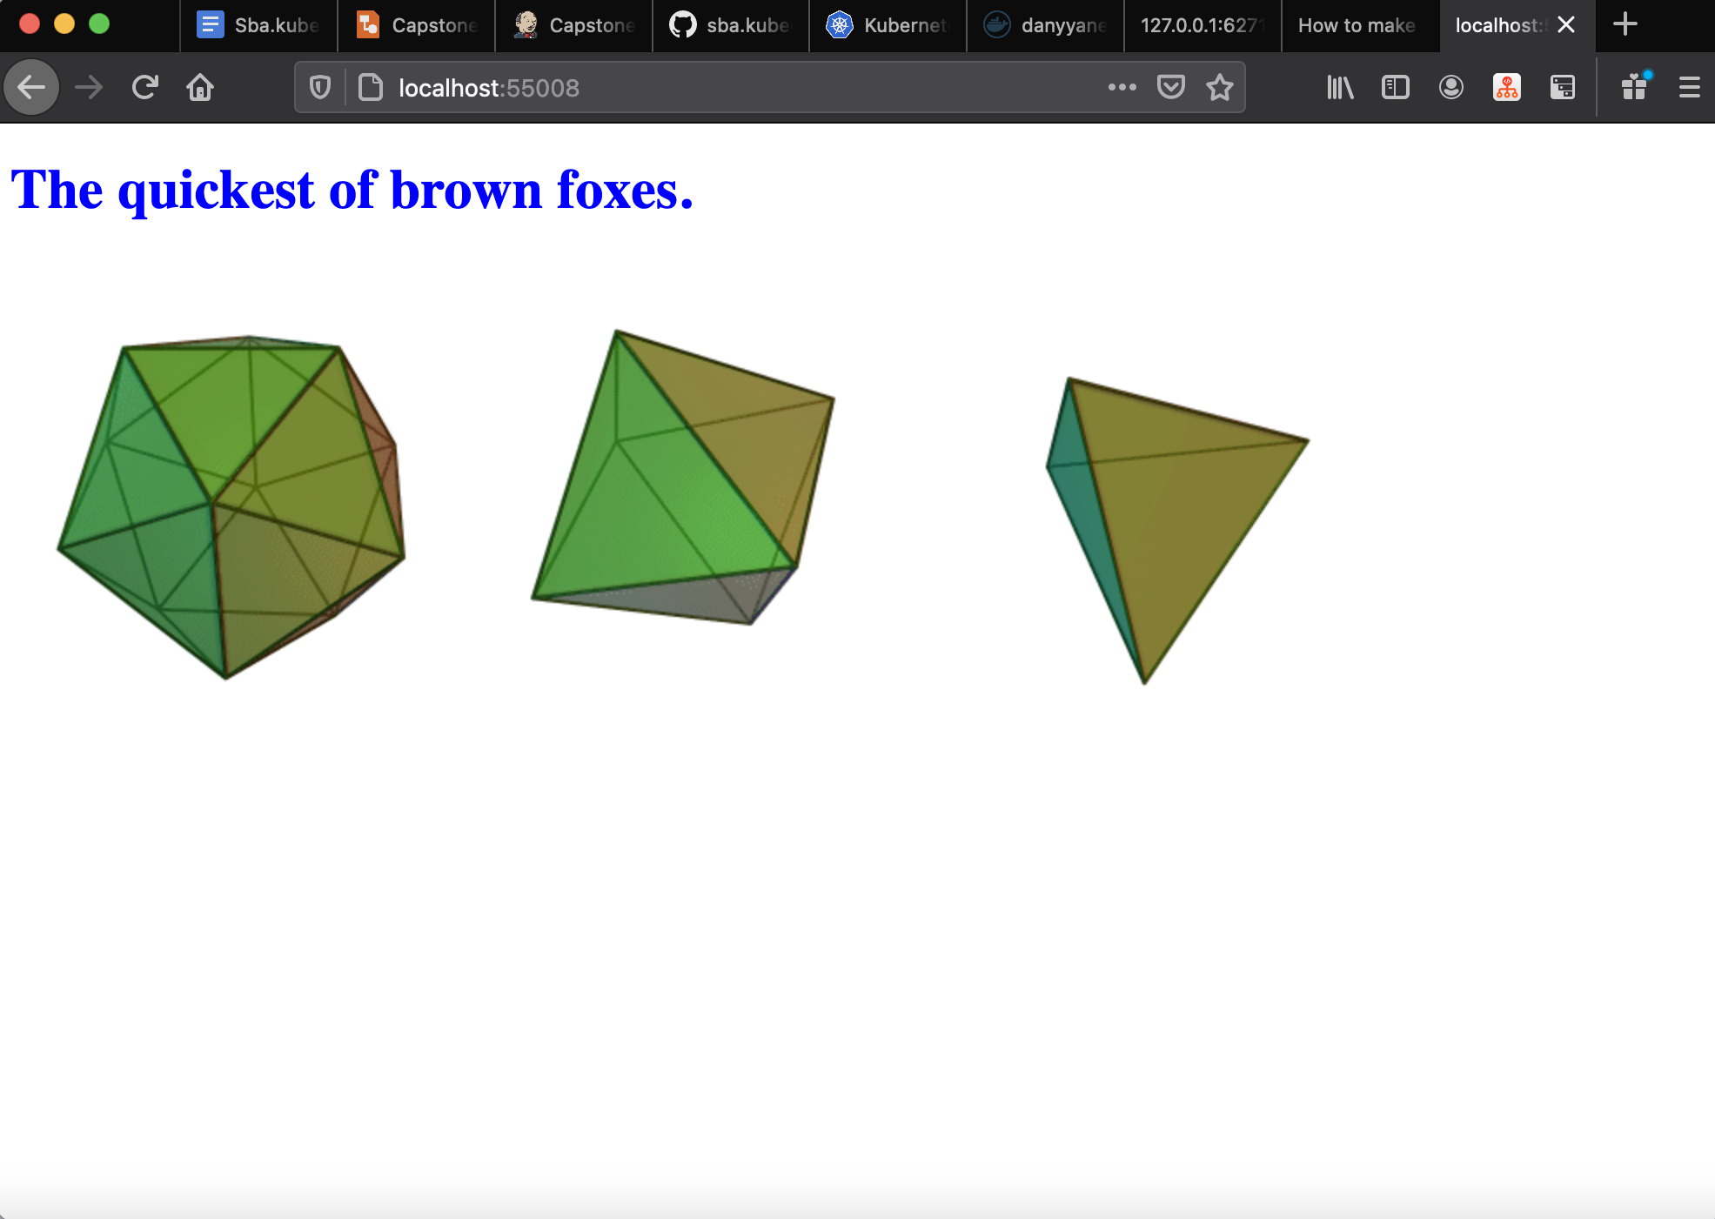

Slide 9
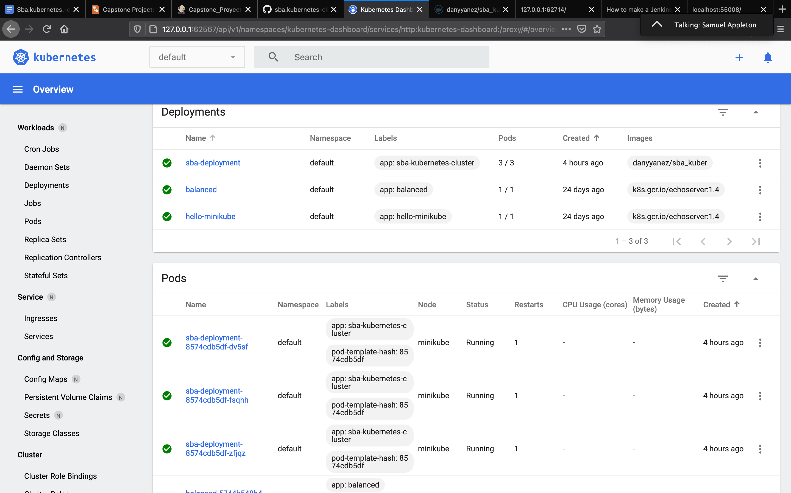

Slide 10
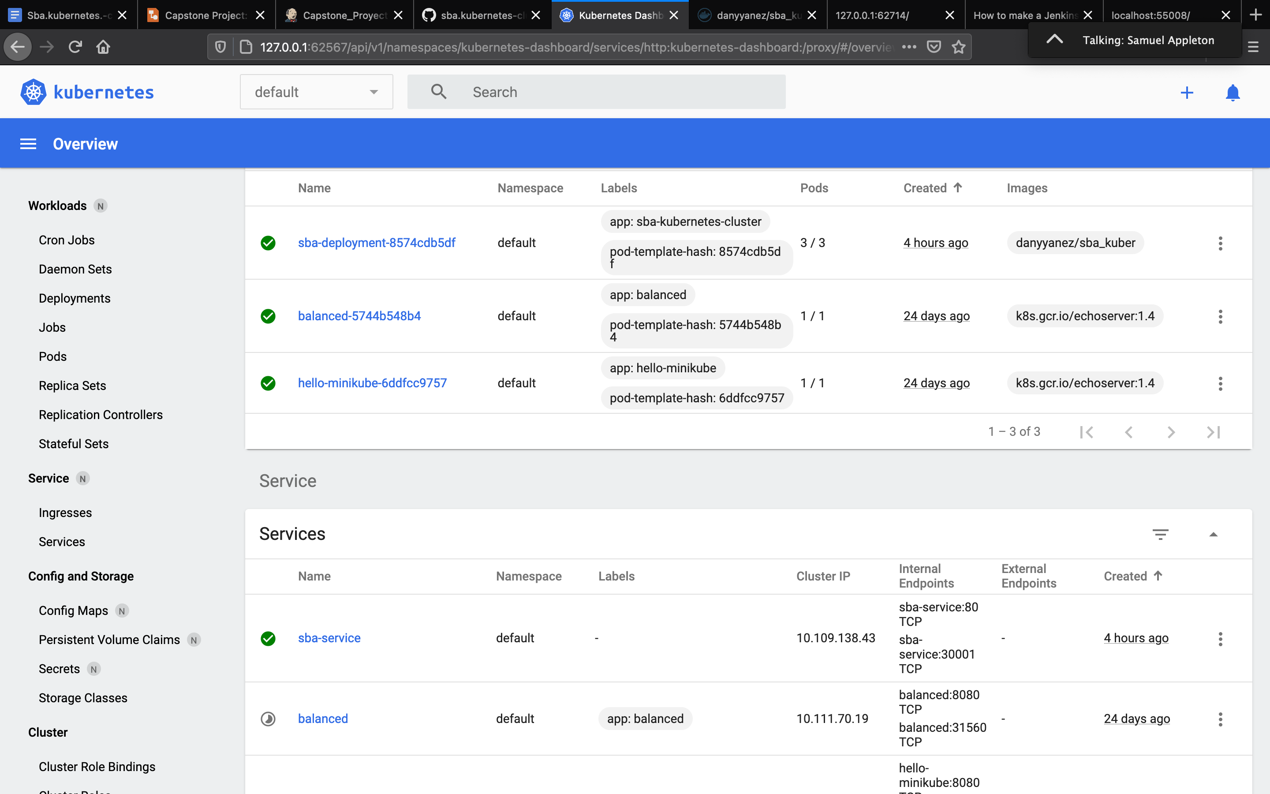

Slide 11
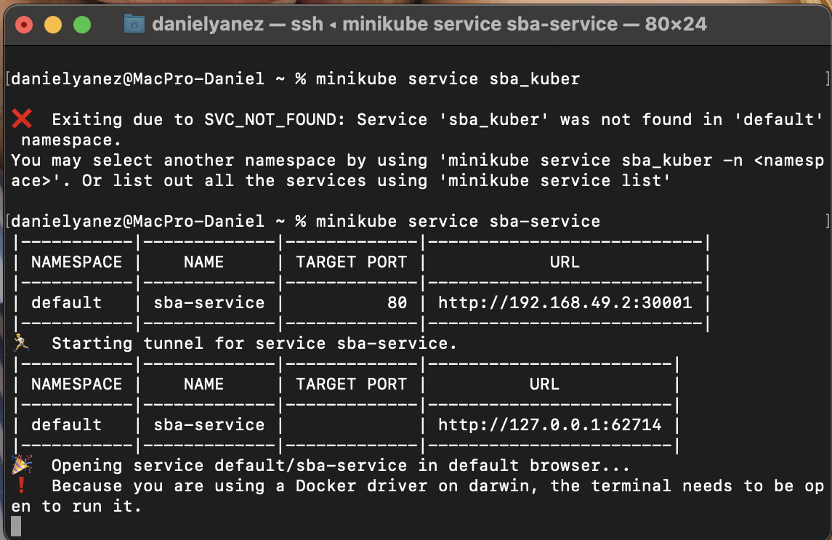

Slide 12
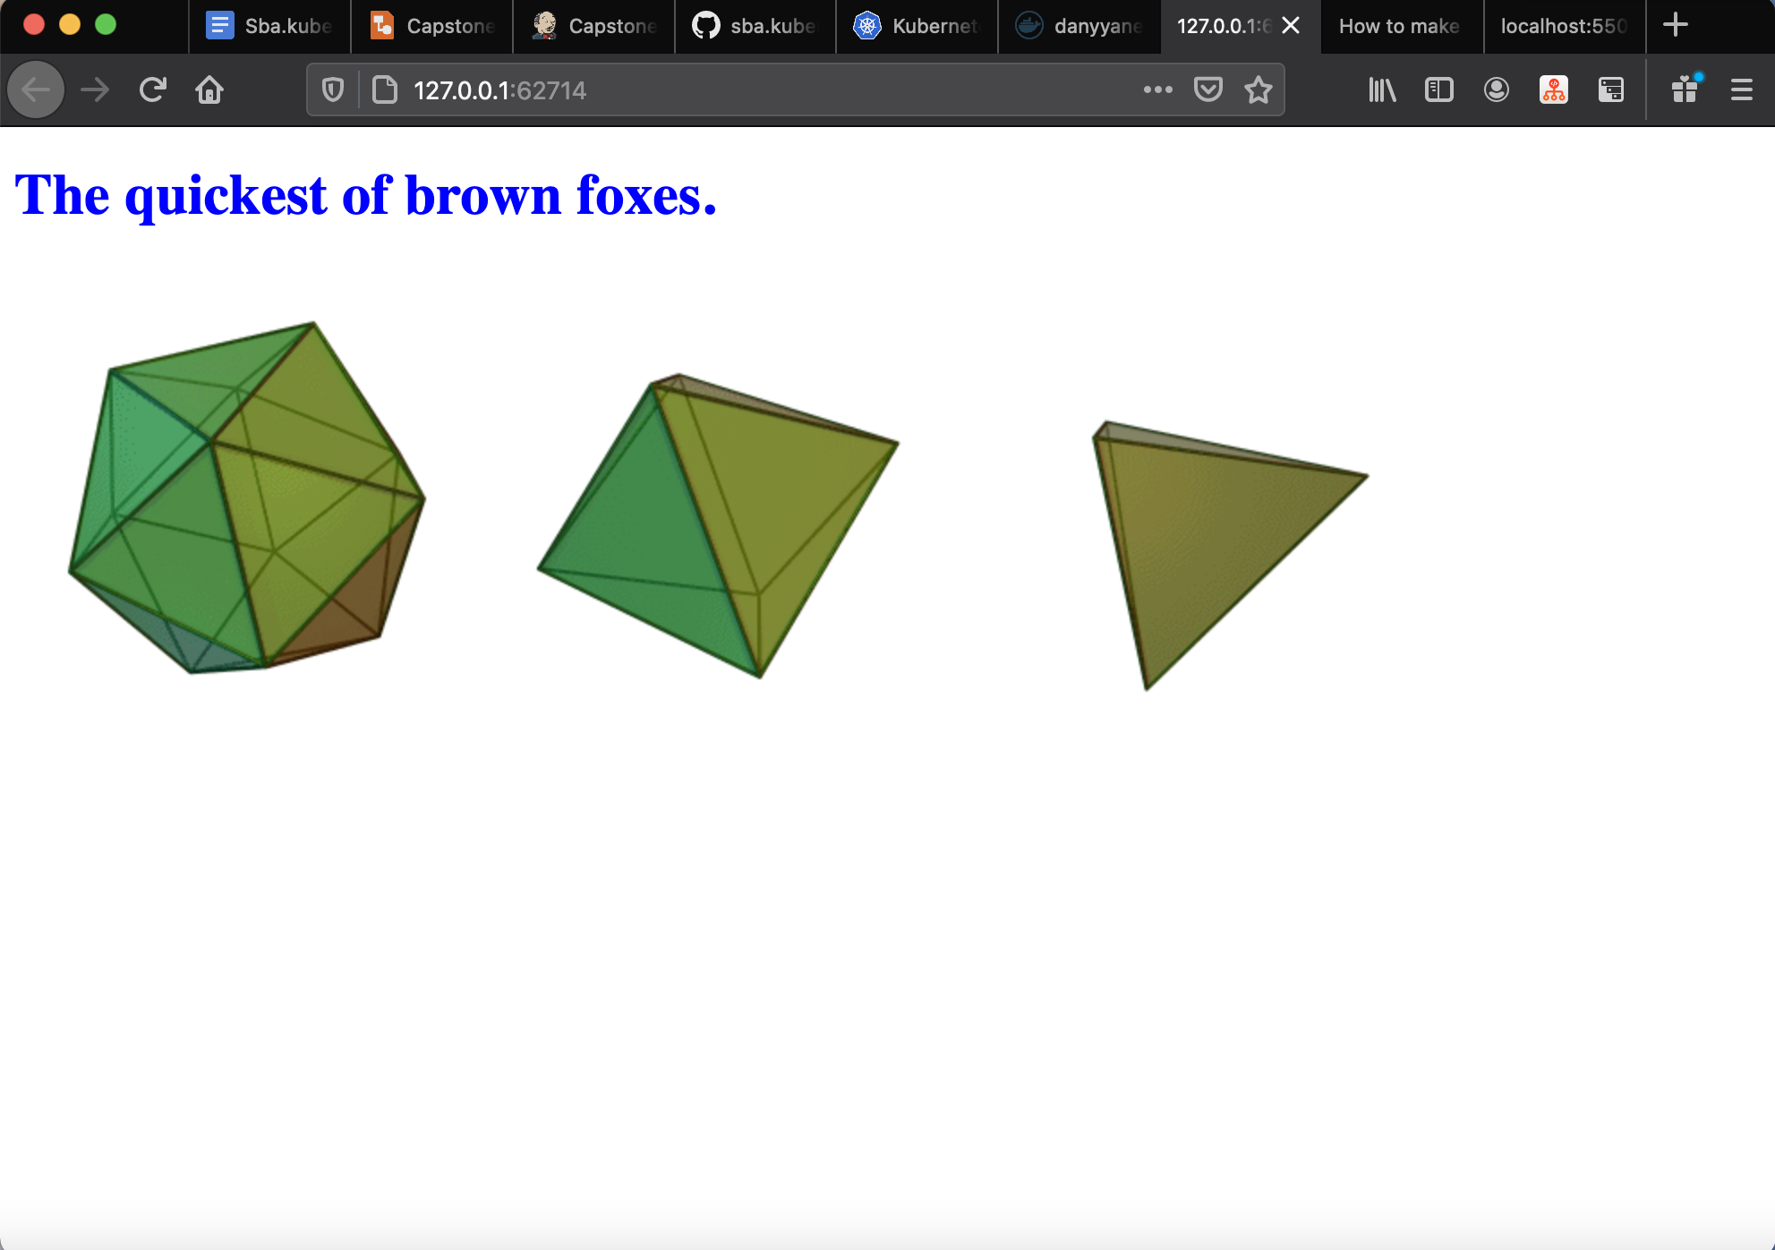

Slide 13
GitHub Repo: https://github.com/DanyYanez/sba.kubernetes-cluster
Dockerfile: https://github.com/DanyYanez/sba.kubernetes-cluster/blob/master/Dockerfile
Jenkinsfile: https://github.com/DanyYanez/sba.kubernetes-cluster/blob/master/Jenkinsfile
Kubernetes.yml: https://github.com/DanyYanez/sba.kubernetes-cluster/blob/master/kubernetes.yaml

Slide 14
Challenges

